Slide 1

Parul University
Session: July-Dec. 2024
Slide No. 1

Slide 2
Parul University
203105374: Design & Analysis of Algorithm
Date
Slide No.

Slide 3
Unit-4
Dynamic programming Knapsack
All pair shortest paths– Warshall’s and Floyd’s algorithms
Resource allocation problem.
Slide No.

Slide 4
Dynamic Programming
Dynamic programming is a technique that breaks the problems into sub-problems, and saves the result for future purposes so that we do not need to compute the result again.
The subproblems are optimized to optimize the overall solution is known as optimal substructure property.
The main use of dynamic programming is to solve optimization problems. Here, optimization problems mean that when we are trying to find out the minimum or the maximum solution of a problem.
The dynamic programming guarantees to find the optimal solution of a problem if the solution exists.
The definition of dynamic programming says that it is a technique for solving a complex problem by first breaking into a collection of simpler sub-problems, solving each sub-problem just once, and then storing their solutions to avoid repetitive computations.
Slide No.

Slide 5
Example
Consider an example of the Fibonacci series. The following series is the Fibonacci series:
0, 1, 1, 2, 3, 5, 8, 13, 21, 34, 55, 89, 144, ,…
The numbers in the above series are not randomly calculated. Mathematically, we could write each of the terms using the below formula:
F(n) = F(n-1) + F(n-2),
With the base values F(0) = 0, and F(1) = 1. To calculate the other numbers, we follow the above relationship. For example, F(2) is the sum f(0) and f(1), which is equal to 1.
Slide No.

Slide 6
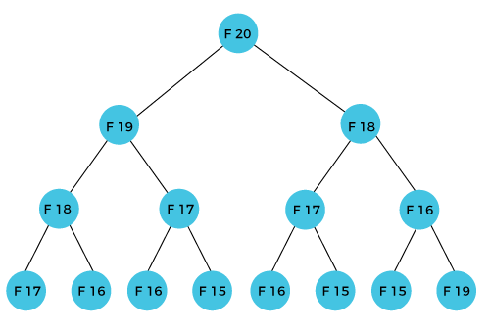
How can we calculate F(20)?
The F(20) term will be calculated using the nth formula of the Fibonacci series. The below figure shows that how F(20) is calculated.
Slide No.

Slide 7
Problem:-
As we can observe in the above figure that F(20) is calculated as the sum of F(19) and F(18). In the dynamic programming approach, we try to divide the problem into the similar subproblems.
We are following this approach in the above case where F(20) into the similar subproblems, i.e., F(19) and F(18).
If we recap the definition of dynamic programming that it says the similar subproblem should not be computed more than once. Still, in the above case, the subproblem is calculated twice.
In the above example, F(18) is calculated two times; similarly, F(17) is also calculated twice. However, this technique is quite useful as it solves the similar subproblems, but we need to be cautious while storing the results because we are not particular about storing the result that we have computed once, then it can lead to a wastage of resources.
In the above example, if we calculate the F(18) in the right subtree, then it leads to the tremendous usage of resources and decreases the overall performance.
Slide No.

Slide 8
Solution:-
The solution to the above problem is to save the computed results in an array. First, we calculate F(16) and F(17) and save their values in an array.
The F(18) is calculated by summing the values of F(17) and F(16), which are already saved in an array. The computed value of F(18) is saved in an array.
The value of F(19) is calculated using the sum of F(18), and F(17), and their values are already saved in an array.
The computed value of F(19) is stored in an array.
The value of F(20) can be calculated by adding the values of F(19) and F(18), and the values of both F(19) and F(18) are stored in an array.
The final computed value of F(20) is stored in an array.
Slide No.

Slide 9
How does the dynamic programming approach work?
The following are the steps that the dynamic programming follows:
It breaks down the complex problem into simpler subproblems.
It finds the optimal solution to these sub-problems.
It stores the results of subproblems (memoization). The process of storing the results of subproblems is known as memorization.
It reuses them so that same sub-problem is calculated more than once.
Finally, calculate the result of the complex problem.
Slide No.

Slide 10
Properties
The dynamic programming is applicable that are having properties such as:
Those problems that are having overlapping subproblems and optimal substructures. Here, optimal substructure means that the solution of optimization problems can be obtained by simply combining the optimal solution of all the subproblems.
In the case of dynamic programming, the space complexity would be increased as we are storing the intermediate results, but the time complexity would be decreased.
Slide No.

Slide 11
Approaches of dynamic programming
There are two approaches to dynamic programming:
Top-down approach
Bottom-up approach
Slide No.

Slide 12
Top-down approach
The top-down approach follows the memorization technique, while bottom-up approach follows the tabulation method. Here memorization is equal to the sum of recursion and caching. Recursion means calling the function itself, while caching means storing the intermediate results.
Advantages
It is very easy to understand and implement.
It solves the sub-problems only when it is required.
It is easy to debug.
Disadvantages
It uses the recursion technique that occupies more memory in the call stack. Sometimes when the recursion is too deep, the stack overflow condition will occur.
It occupies more memory that degrades the overall performance.
Slide No.

Slide 13
EXAMPLE
Let's understand dynamic programming through an example.
int fib(int n)
{
if(n<0)
error;
if(n==0)
return 0;
if(n==1)
return 1;
sum = fib(n-1) + fib(n-2);
}
Slide No.

Slide 14
Cont…
In the above code, we have used the recursive approach to find out the Fibonacci series. When the value of 'n' increases, the function calls will also increase, and computations will also increase. In this case, the time complexity increases exponentially, and it becomes 2n.
One solution to this problem is to use the dynamic programming approach. Rather than generating the recursive tree again and again, we can reuse the previously calculated value. If we use the dynamic programming approach, then the time complexity would be O(n).
When we apply the dynamic programming approach in the implementation of the Fibonacci series, then the code would look like:
Slide No.

Slide 15
static int count = 0;
int fib(int n)
{
if(memo[n]!= NULL)
return memo[n];
count++;
if(n<0)
error;
if(n==0)
return 0;
if(n==1)
return 1;
sum = fib(n-1) + fib(n-2);
memo[n] = sum;
}
In the above code, we have used the memorization technique in which we store the results in an array to reuse the values.
This is also known as a top-down approach in which we move from the top and break the problem into sub-problems.
Slide No.

Slide 16
Bottom-Up approach
The bottom-up approach is also one of the techniques which can be used to implement the dynamic programming.
It uses the tabulation technique to implement the dynamic programming approach.
It solves the same kind of problems but it removes the recursion.
If we remove the recursion, there is no stack overflow issue and no overhead of the recursive functions.
In this tabulation technique, we solve the problems and store the results in a matrix.
The bottom-up is the approach used to avoid the recursion, thus saving the memory space. The bottom-up is an algorithm that starts from the beginning, whereas the recursive algorithm starts from the end and works backward. In the bottom-up approach, we start from the base case to find the answer for the end. As we know, the base cases in the Fibonacci series are 0 and 1. Since the bottom approach starts from the base cases, so we will start from 0 and 1.
Slide No.

Slide 17
Cont…
Key points
We solve all the smaller sub-problems that will be needed to solve the larger sub-problems then move to the larger problems using smaller sub-problems.
We use for loop to iterate over the sub-problems.
The bottom-up approach is also known as the tabulation or table filling method.
Slide No.

Slide 18

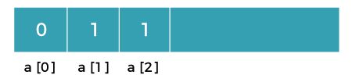
Let's understand through an example.
Suppose we have an array that has 0 and 1 values at a[0] and a[1] positions, respectively shown as below:
Since the bottom-up approach starts from the lower values, so the values at a[0] and a[1] are added to find the value of a[2] shown as below:
Slide No.

Slide 19
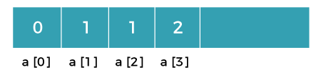


The value of a[3] will be calculated by adding a[1] and a[2], and it becomes 2 shown as below:
The value of a[4] will be calculated by adding a[2] and a[3], and it becomes 3 shown as below:
The value of a[5] will be calculated by adding the values of a[4] and a[3], and it becomes 5 shown as below:
Slide No.

Slide 20
The code for implementing the Fibonacci series using the bottom-up approach is given below:
int fib(int n)
{
int A[];
A[0] = 0, A[1] = 1;
for( i=2; i<=n; i++)
{
A[i] = A[i-1] + A[i-2]
}
return A[n];
}
Slide No.

Slide 21
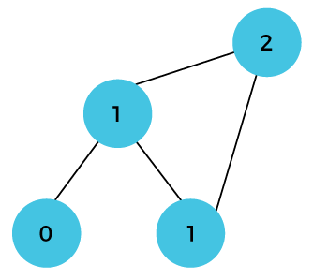
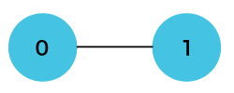
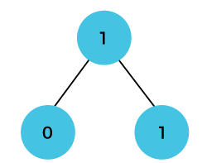
DiagrammaticRepresentation.
In the above code, base cases are 0 and 1 and then we have used for loop to find other values of Fibonacci series.
Initially, the first two values, i.e., 0 and 1 can be represented as:
When i=2 then the values 0 and 1 are added shown as below:
When i=3 then the values 1and 1 are added shown as below:
Slide No.

Slide 22
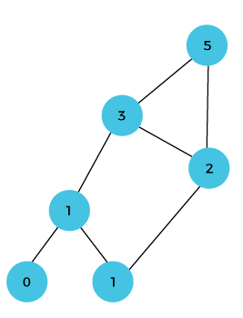
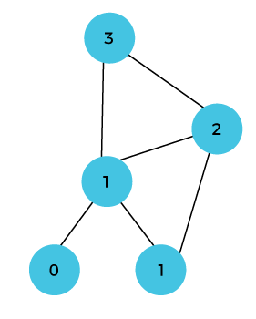
When i=4 then the values 2 and 1 are added shown as below:
When i=5, then the values 3 and 2 are added shown as below:
Slide No.

Slide 23
0/1 knapsack problem
The 0/1 knapsack problem means that the items are either completely or no items are filled in a knapsack.
For example, we have two items having weights 2kg and 3kg, respectively.
If we pick the 2kg item then we cannot pick 1kg item from the 2kg item (item is not divisible)
we have to pick the 2kg item completely. This is a 0/1 knapsack problem in which either we pick the item completely or we will pick that item.
The 0/1 knapsack problem is solved by the dynamic programming.
Slide No.

Slide 24
Example of 0/1 knapsack problem.
Consider the problem having weights and profits are:
Weights: {3, 4, 6, 5}
Profits: {2, 3, 1, 4}
The weight of the knapsack is 8 kg
The number of items is 4
The above problem can be solved by using the following method:
xi = {1, 0, 0, 1}
= {0, 0, 0, 1}
= {0, 1, 0, 1}
The above are the possible combinations. 1 denotes that the item is completely picked and 0 means that no item is picked. Since there are 4 items so possible combinations will be:
Slide No.

Slide 25
Cont…
2^4 = 16; So. There are 16 possible combinations that can be made by using the above problem. Once all the combinations are made, we have to select the combination that provides the maximum profit.
Another approach to solve the problem is dynamic programming approach. In dynamic programming approach, the complicated problem is divided into sub-problems, then we find the solution of a sub-problem and the solution of the sub-problem will be used to find the solution of a complex problem.
V[i,w]=maximum{V[i-1,w], V[i-1,w-w[i] + P[i]}
Slide No.

Slide 26
How this problem can be solved by using the Dynamic programming approach?
First,
we create a matrix shown as below: V[i,w]=maximum{V[i-1,w], V[i-1,w-w[i] + P[i]}
 | 0 | 1 | 2 | 3 | 4 | 5 | 6 | 7 | 8
0
1
2
3
4
Slide No.

Slide 27
In the above matrix, columns represent the weight, i.e., 8. The rows represent the profits and weights of items. Here we have not taken the weight 8 directly, problem is divided into sub-problems, i.e., 0, 1, 2, 3, 4, 5, 6, 7, 8.
The solution of the sub-problems would be saved in the cells and answer to the problem would be stored in the final cell. First, we write the weights in the ascending order and profits according to their weights shown as below:
wi = {3, 4, 5, 6}
pi = {2, 3, 4, 1}The first row and the first column would be 0 as there is no item for w=0
 | 0 | 1 | 2 | 3 | 4 | 5 | 6 | 7 | 8
0 | 0 | 0 | 0 | 0 | 0 | 0 | 0 | 0 | 0
1 | 0
2 | 0
3 | 0
4 | 0
Slide No.

Slide 28
When i=1, W=1
w1 = 3; Since we have only one item in the set having weight 3, but the capacity of the knapsack is 1. We cannot fill the item of 3kg in the knapsack of capacity 1 kg so add 0 at M[1][1] shown as below:
When i = 1, W = 2
w₁ = 3; Since we have only one item in the set having weight 3, but the capacity of the knapsack is 2. We cannot fill the item of 3kg in the knapsack of capacity 2 kg so add 0 at M[1][2] shown as below:
 | 0 | 1 | 2 | 3 | 4 | 5 | 6 | 7 | 8
0 | 0 | 0 | 0 | 0 | 0 | 0 | 0 | 0 | 0
1 | 0 | 0
2 | 0
3 | 0
4 | 0
 | 0 | 1 | 2 | 3 | 4 | 5 | 6 | 7 | 8
0 | 0 | 0 | 0 | 0 | 0 | 0 | 0 | 0 | 0
1 | 0 | 0 | 0
2 | 0
3 | 0
4 | 0
Slide No.

Slide 29
When i=1, W=3
w1 = 3; Since we have only one item in the set having weight equal to 3, and weight of the knapsack is also 3; therefore, we can fill the knapsack with an item of weight equal to 3. We put profit corresponding to the weight 3, i.e., 2 at M[1][3] shown as below:
When i=1, W = 4
W1 = 3; Since we have only one item in the set having weight equal to 3, and weight of the knapsack is 4; therefore, we can fill the knapsack with an item of weight equal to 3. We put profit corresponding to the weight 3, i.e., 2 at M[1][4] shown as below:
 | 0 | 1 | 2 | 3 | 4 | 5 | 6 | 7 | 8
0 | 0 | 0 | 0 | 0 | 0 | 0 | 0 | 0 | 0
1 | 0 | 0 | 0 | 2
2 | 0
3 | 0
4 | 0
 | 0 | 1 | 2 | 3 | 4 | 5 | 6 | 7 | 8
0 | 0 | 0 | 0 | 0 | 0 | 0 | 0 | 0 | 0
1 | 0 | 0 | 0 | 2 | 2
2 | 0
3 | 0
4 | 0
Slide No.

Slide 30
When i=1, W = 5
_{W1} = 3; Since we have only one item in the set having weight equal to 3, and weight of the knapsack is 5; therefore, we can fill the knapsack with an item of weight equal to 3. We put profit corresponding to the weight 3, i.e., 2 at M[1][5] shown as below:
When i =1, W=6
_{W1} = 3; Since we have only one item in the set having weight equal to 3, and weight of the knapsack is 6; therefore, we can fill the knapsack with an item of weight equal to 3. We put profit corresponding to the weight 3, i.e., 2 at M[1][6] shown as below:
 | 0 | 1 | 2 | 3 | 4 | 5 | 6 | 7 | 8
0 | 0 | 0 | 0 | 0 | 0 | 0 | 0 | 0 | 0
1 | 0 | 0 | 0 | 2 | 2 | 2
2 | 0
3 | 0
4 | 0
 | 0 | 1 | 2 | 3 | 4 | 5 | 6 | 7 | 8
0 | 0 | 0 | 0 | 0 | 0 | 0 | 0 | 0 | 0
1 | 0 | 0 | 0 | 2 | 2 | 2 | 2
2 | 0
3 | 0
4 | 0
Slide No.

Slide 31
When i=1, W = 7
W1 = 3; Since we have only one item in the set having weight equal to 3, and weight of the knapsack is 7; therefore, we can fill the knapsack with an item of weight equal to 3. We put profit corresponding to the weight 3, i.e., 2 at M[1][7] shown as below:
When i =1, W =8
W1= 3; Since we have only one item in the set having weight equal to 3, and weight of the knapsack is 8; therefore, we can fill the knapsack with an item of weight equal to 3. We put profit corresponding to the weight 3, i.e., 2 at M[1][8] shown as below:
 | 0 | 1 | 2 | 3 | 4 | 5 | 6 | 7 | 8
0 | 0 | 0 | 0 | 0 | 0 | 0 | 0 | 0 | 0
1 | 0 | 0 | 0 | 2 | 2 | 2 | 2 | 2
2 | 0
3 | 0
4 | 0
 | 0 | 1 | 2 | 3 | 4 | 5 | 6 | 7 | 8
0 | 0 | 0 | 0 | 0 | 0 | 0 | 0 | 0 | 0
1 | 0 | 0 | 0 | 2 | 2 | 2 | 2 | 2 | 2
2 | 0
3 | 0
4 | 0
Slide No.

Slide 32
When i =2, W = 2
The weight corresponding to the value 2 is 4, i.e., w₂ = 4. Since we have only one item in the set having weight equal to 4, and the weight of the knapsack is 2. We cannot put the item of weight 4 in a knapsack, so we add 0 at M[2][2] shown as below:
When i =2, W = 3
The weight corresponding to the value 2 is 4, i.e., w₂ = 4. Since we have two items in the set having weights 3 and 4, and the weight of the knapsack is 3. We can put the item of weight 3 in a knapsack, so we add 2 at M[2][3] shown as below:
When i =2, W = 4
The weight corresponding to the value 2 is 4, i.e., w2 = 4. Since we have two items in the set having weights 3 and 4, and the weight of the knapsack is 4. We can put item of weight 4 in a knapsack as the profit corresponding to weight 4 is more than the item having weight 3, so we add 3 at M[2][4] shown as below:
Slide No.

Slide 33
When i = 2, W = 5
The weight corresponding to the value 2 is 4, i.e., w₂ = 4. Since we have two items in the set having weights 3 and 4, and the weight of the knapsack is 5. We can put item of weight 4 in a knapsack and the profit corresponding to weight is 3, so we add 3 at M[2][5] shown as below:
When i = 2, W = 6
The weight corresponding to the value 2 is 4, i.e., w₂ = 4. Since we have two items in the set having weights 3 and 4, and the weight of the knapsack is 6. We can put item of weight 4 in a knapsack and the profit corresponding to weight is 3, so we add 3 at M[2][6] shown as below:
When i = 2, W = 7
The weight corresponding to the value 2 is 4, i.e., w₂ = 4. Since we have two items in the set having weights 3 and 4, and the weight of the knapsack is 7. We can put item of weight 4 and 3 in a knapsack and the profits corresponding to weights are 2 and 3; therefore, the total profit is 5, so we add 5 at M[2][7] shown as below:
Slide No.

Slide 34
When i = 2, W = 8
The weight corresponding to the value 2 is 4, i.e., w₂ = 4. Since we have two items in the set having weights 3 and 4, and the weight of the knapsack is 7. We can put item of weight 4 and 3 in a knapsack and the profits corresponding to weights are 2 and 3; therefore, the total profit is 5, so we add 5 at M[2][7] shown as below:
 | 0 | 1 | 2 | 3 | 4 | 5 | 6 | 7 | 8
0 | 0 | 0 | 0 | 0 | 0 | 0 | 0 | 0 | 0
1 | 0 | 0 | 0 | 2 | 2 | 2 | 2 | 2 | 2
2 | 0 | 0 | 0 | 2 | 3 | 3 | 3 | 5 | 5
3 | 0
4 | 0
Slide No.

Slide 35
Now the value of 'i' gets incremented, and becomes 3.
When i = 3, W = 1
The weight corresponding to the value 3 is 5, i.e., w₃ = 5. Since we have three items in the set having weights 3, 4, and 5, and the weight of the knapsack is 1. We cannot put neither of the items in a knapsack, so we add 0 at M[3][1] shown as below:
When i = 3, W = 2
The weight corresponding to the value 3 is 5, i.e., w₃ = 5. Since we have three items in the set having weight 3, 4, and 5, and the weight of the knapsack is 1. We cannot put neither of the items in a knapsack, so we add 0 at M[3][2] shown as below:
When i = 3, W = 3
The weight corresponding to the value 3 is 5, i.e., w₃ = 5. Since we have three items in the set of weight 3, 4, and 5 respectively and weight of the knapsack is 3. The item with a weight 3 can be put in the knapsack and the profit corresponding to the item is 2, so we add 2 at M[3][3] shown as below:
Slide No.

Slide 36
When i = 3, W = 4
The weight corresponding to the value 3 is 5, i.e., w₃ = 5. Since we have three items in the set of weight 3, 4, and 5 respectively, and weight of the knapsack is 4. We can keep the item of either weight 3 or 4; the profit (3) corresponding to the weight 4 is more than the profit corresponding to the weight 3 so we add 3 at M[3][4] shown as below:
When i = 3, W = 5
The weight corresponding to the value 3 is 5, i.e., w₃ = 5. Since we have three items in the set of weight 3, 4, and 5 respectively, and weight of the knapsack is 5. We can keep the item of either weight 3, 4 or 5; the profit (3) corresponding to the weight 4 is more than the profits corresponding to the weight 3 and 5 so we add 3 at M[3][5] shown as below:
When i =3, W = 6
The weight corresponding to the value 3 is 5, i.e., w₃ = 5. Since we have three items in the set of weight 3, 4, and 5 respectively, and weight of the knapsack is 6. We can keep the item of either weight 3, 4 or 5; the profit (3) corresponding to the weight 4 is more than the profits corresponding to the weight 3 and 5 so we add 3 at M[3][6] shown as below:
Slide No.

Slide 37
When i =3, W = 7
The weight corresponding to the value 3 is 5, i.e., w₃ = 5. Since we have three items in the set of weight 3, 4, and 5 respectively, and weight of the knapsack is 7. In this case, we can keep both the items of weight 3 and 4, the sum of the profit would be equal to (2 + 3), i.e., 5, so we add 5 at M[3][7] shown as below:
When i = 3, W = 8
The weight corresponding to the value 3 is 5, i.e., w₃ = 5. Since we have three items in the set of weight 3, 4, and 5 respectively, and the weight of the knapsack is 8. In this case, we can keep both the items of weight 3 and 4, the sum of the profit would be equal to (2 + 3), i.e., 5, so we add 5 at M[3][8] shown as below:
Slide No.

Slide 38
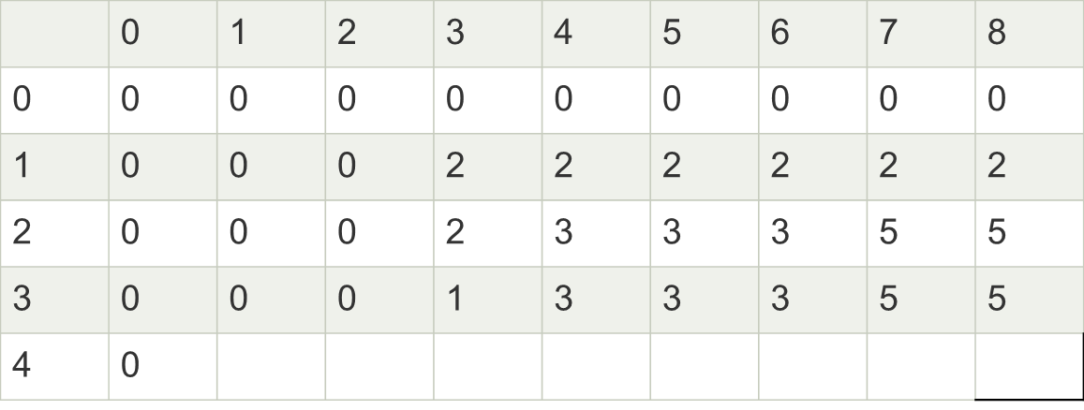
Slide No.

Slide 39
Now the value of 'i' gets incremented and becomes 4.
When i = 4, W = 1
The weight corresponding to the value 4 is 6, i.e., w₄ = 6. Since we have four items in the set of weights 3, 4, 5, and 6 respectively, and the weight of the knapsack is 1. The weight of all the items is more than the weight of the knapsack, so we cannot add any item in the knapsack; Therefore, we add 0 at M[4][1] shown as below:
When i = 4, W = 2
The weight corresponding to the value 4 is 6, i.e., w₄ = 6. Since we have four items in the set of weights 3, 4, 5, and 6 respectively, and the weight of the knapsack is 2. The weight of all the items is more than the weight of the knapsack, so we cannot add any item in the knapsack; Therefore, we add 0 at M[4][2] shown as below:
When i = 4, W = 3
The weight corresponding to the value 4 is 6, i.e., w₄ = 6. Since we have four items in the set of weights 3, 4, 5, and 6 respectively, and the weight of the knapsack is 3. The item with a weight 3 can be put in the knapsack and the profit corresponding to the weight 4 is 2, so we will add 2 at M[4][3] shown as below:
Slide No.

Slide 40
When i = 4, W = 4
The weight corresponding to the value 4 is 6, i.e., w₄ = 6. Since we have four items in the set of weights 3, 4, 5, and 6 respectively, and the weight of the knapsack is 4. The item with a weight 4 can be put in the knapsack and the profit corresponding to the weight 4 is 3, so we will add 3 at M[4][4] shown as below:
When i = 4, W = 5
The weight corresponding to the value 4 is 6, i.e., w₄ = 6. Since we have four items in the set of weights 3, 4, 5, and 6 respectively, and the weight of the knapsack is 5. The item with a weight 4 can be put in the knapsack and the profit corresponding to the weight 4 is 3, so we will add 3 at M[4][5] shown as below:
When i = 4, W = 6
The weight corresponding to the value 4 is 6, i.e., w₄ = 6. Since we have four items in the set of weights 3, 4, 5, and 6 respectively, and the weight of the knapsack is 6. In this case, we can put the items in the knapsack either of weight 3, 4, 5 or 6 but the profit, i.e., 4 corresponding to the weight 6 is highest among all the items; therefore, we add 4 at M[4][6] shown as below:
Slide No.

Slide 41
When i = 4, W = 7
The weight corresponding to the value 4 is 6, i.e., w₄ = 6. Since we have four items in the set of weights 3, 4, 5, and 6 respectively, and the weight of the knapsack is 7. Here, if we add two items of weights 3 and 4 then it will produce the maximum profit, i.e., (2 + 3) equals to 5, so we add 5 at M[4][7] shown as below:
When i = 4, W = 8
The weight corresponding to the value 4 is 6, i.e., w₄ = 6. Since we have four items in the set of weights 3, 4, 5, and 6 respectively, and the weight of the knapsack is 8. Here, if we add two items of weights 3 and 4 then it will produce the maximum profit, i.e., (2 + 3) equals to 5, so we add 5 at M[4][8] shown as below:
Slide No.

Slide 42
Final table
 | 0 | 1 | 2 | 3 | 4 | 5 | 6 | 7 | 8
0 | 0 | 0 | 0 | 0 | 0 | 0 | 0 | 0 | 0
1 | 0 | 0 | 0 | 2 | 2 | 2 | 2 | 2 | 2
2 | 0 | 0 | 0 | 2 | 3 | 3 | 3 | 5 | 5
3 | 0 | 0 | 0 | 2 | 3 | 3 | 3 | 5 | 5
4 | 0 | 0 | 0 | 2 | 3 | 3 | 4 | 5 | 5
Slide No.

Slide 43
As we can observe in the above table that 5 is the maximum profit among all the entries. The pointer points to the last row and the last column having 5 value. Now we will compare 5 value with the previous row; if the previous row, i.e., i = 3 contains the same value 5 then the pointer will shift upwards. Since the previous row contains the value 5 so the pointer will be shifted upwards as shown in the below table:
Again, we will compare the value 5 from the above row, i.e., i = 2. Since the above row contains the value 5 so the pointer will again be shifted upwards :
Again, we will compare the value 5 from the above row, i.e., i = 1. Since the above row does not contain the same value so we will consider the row i=1, and the weight corresponding to the row is 4. Therefore, we have selected the weight 4 and we have rejected the weights 5 and 6 shown below:
x = { 1, 0, 0}
The profit corresponding to the weight is 3. Therefore, the remaining profit is (5 - 3) equals to 2. Now we will compare this value 2 with the row i = 2. Since the row (i = 1) contains the value 2; therefore, the pointer shifted upwards shown below:
Slide No.

Slide 44
Again we compare the value 2 with a above row, i.e., i = 1. Since the row i =0 does not contain the value 2, so row i = 1 will be selected and the weight corresponding to the i = 1 is 3 shown below:
X = {1, 1, 0, 0}
The profit corresponding to the weight is 2. Therefore, the remaining profit is 0. We compare 0 value with the above row. Since the above row contains a 0 value but the profit corresponding to this row is 0. In this problem, two weights are selected, i.e., 3 and 4 to maximize the profit.
Slide No.

Slide 45
0-1 Knapsack Algorithm
Dynamic-0-1-knapsack (v, w, n, W)
for w = 0 to W do
c[0, w] = 0
for i = 1 to n do
c[i, 0] = 0
for w = 1 to W do
if wi ≤ w then
if vi + c[i-1, w-wi] then
c[i, w] = vi + c[i-1, w-wi]
else c[i, w] = c[i-1, w]
else
c[i, w] = c[i-1, w]
Slide No.

Slide 46
Problem Statement − A thief is robbing a store and can carry a maximal weight of W into his knapsack. There are n items and weight of i^{th} item is wi and the profit of selecting this item is pi. What items should the thief take?
Let i be the highest-numbered item in an optimal solution S for W dollars. Then S’ = S − {i} is an optimal solution for W – w_{i} dollars and the value to the solution S is V_{i} plus the value of the sub-problem.
We can express this fact in the following formula: define c[i, w] to be the solution for items 1,2, … , i and the maximum weight w.
The algorithm takes the following inputs
The maximum weight W
The number of items n
The two sequences v = <v1, v2, …, vn> and w = <w1, w2, …, wn>
The set of items to take can be deduced from the table, starting at c[n, w] and tracing backwards where the optimal values came from.
If c[i, w] = c[i-1, w], then item i is not part of the solution, and we continue tracing with c[i-1, w]. Otherwise, item i is part of the solution, and we continue tracing with c [i-1, w-W].
Slide No.

Slide 47
Floyd Warshall Algorithm
The Floyd Warshall Algorithm is for solving all pairs of shortest-path problems. The problem is to find the shortest distances between every pair of vertices in a given edge-weighted directed Graph.
It is an algorithm for finding the shortest path between all the pairs of vertices in a weighted graph. This algorithm follows the dynamic programming approach to find the shortest path.
A C-function for a N x N graph is given below. The function stores the all pair shortest path in the matrix cost [N][N]. The cost matrix of the given graph is available in cost Mat [N][N].
Slide No.

Slide 48
Floyd Warshall Algorithm:
# define N 4
void floydwarshall()
{
int cost [N][N];
int i, j, k;
for(i=0; i<N; i++)
for(j=0; j<N; j++)
cost [i][j]= cost Mat [i] [i];
for(k=0; k<N; k++)
{
for(i=0; i<N; i++)
for(j=0; j<N; j++)
if(cost [i][j]> cost [i] [k] + cost [k][j];
cost [i][j]=cost [i] [k]+'cost [k] [j]:
}
//display the matrix cost [N] [N]
}
Slide No.

Slide 49
How algorithm Works?
Initialize the solution matrix same as the input graph matrix as a first step.
Then update the solution matrix by considering all vertices as an intermediate vertex.
The idea is to one by one pick all vertices and updates all shortest paths which include the picked vertex as an intermediate vertex in the shortest path.
When we pick vertex number k as an intermediate vertex, we already have considered vertices {0, 1, 2, .. k-1} as intermediate vertices.
For every pair (i, j) of the source and destination vertices respectively, there are two possible cases.
k is not an intermediate vertex in shortest path from i to j. We keep the value of dist[i][j] as it is.
k is an intermediate vertex in shortest path from i to j. We update the value of dist[i][j] as dist[i][k] + dist[k][j] if dist[i][j] > dist[i][k] + dist[k][j]
Slide No.

Slide 50
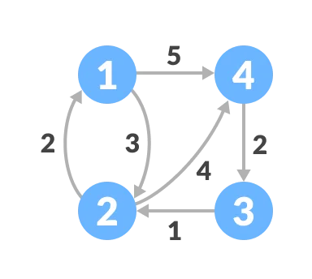
Let's see at an example to illustrate how the Floyd-Warshall algorithm works:
Follow the steps below to find the shortest path between all the pairs of vertices.
Create a matrix A⁰ of dimension n*n where n is the number of vertices. The row and the column are indexed as i and j respectively. i and j are the vertices of the graph.
1. Each cell A[i][j] is filled with the distance from the i^{th} vertex to the j^{th} vertex. If there is no path from i^{th} vertex to j^{th} vertex, the cell is left as infinity.
Slide No.

Slide 51
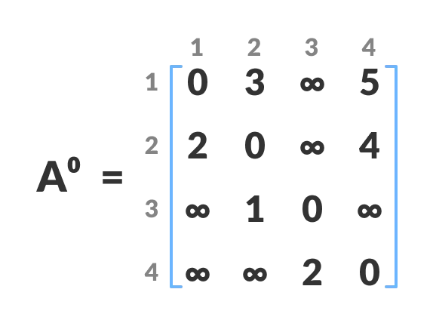
2. Fill each cell with the distance between ith and jth vertex
Now, create a matrix A¹ using matrix A⁰. The elements in the first column and the first row are left as they are. The remaining cells are filled in the following way. Let k be the intermediate vertex in the shortest path from source to destination. In this step, k is the first vertex. A[i][j] is filled with (A[i][k] + A[k][j]) if (A[i][j] > A[i][k] + A[k][j]). That is, if the direct distance from the source to the destination is greater than the path through the vertex k, then the cell is filled with A[i][k] + A[k][j]. In this step, k is vertex 1. We calculate the distance from source vertex to destination vertex through this vertex k.
Slide No.

Slide 52
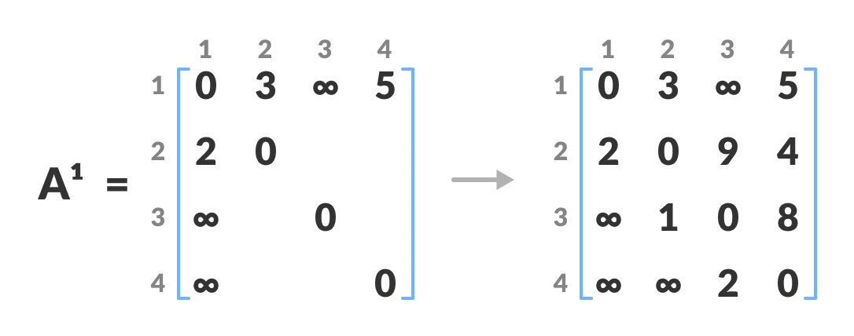
For example: For A1[2, 4], the direct distance from vertex 2 to 4 is 4 and the sum of the distance from vertex 2 to 4 through vertex (ie. from vertex 2 to 1 and from vertex 1 to 4) is 7. Since 4 < 7, A0[2, 4] is filled with 4.
Slide No.

Slide 53
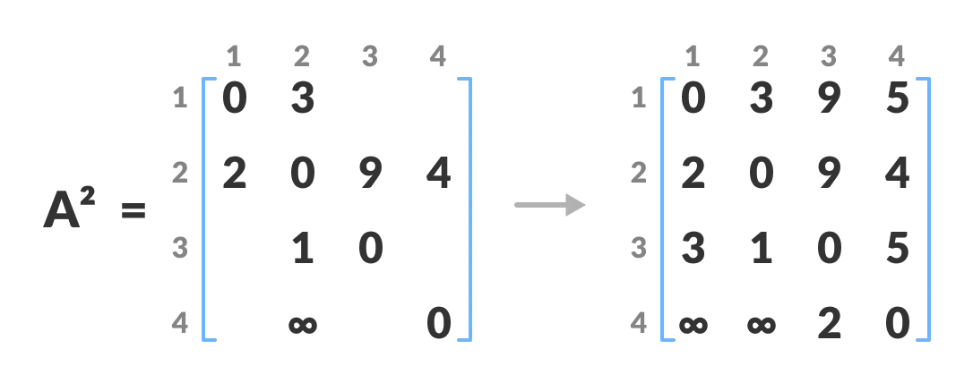
3. Similarly, A² is created using A¹. The elements in the second column and the second row are left as they are. In this step, k is the second vertex (i.e. vertex 2). The remaining steps are the same as in step 2.
Calculate the distance from the source vertex to destination vertex through this vertex 2
Slide No.

Slide 54
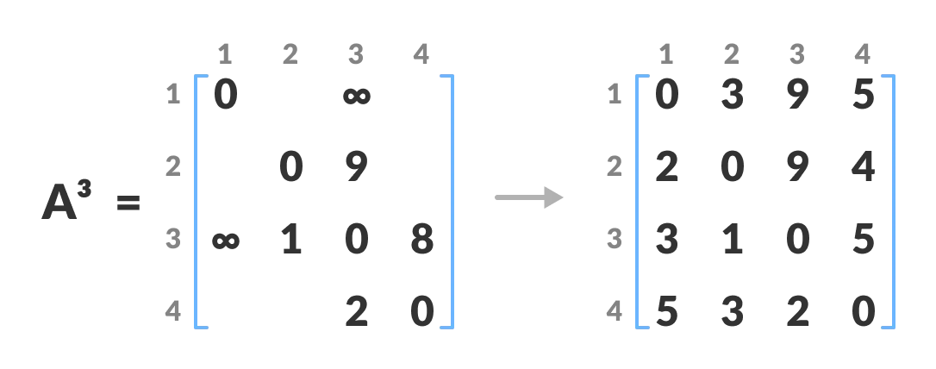
4. Similarly, A³ and A⁴ is also created.
Calculate the distance from the source vertex to destination vertex through this vertex 3
Slide No.

Slide 55
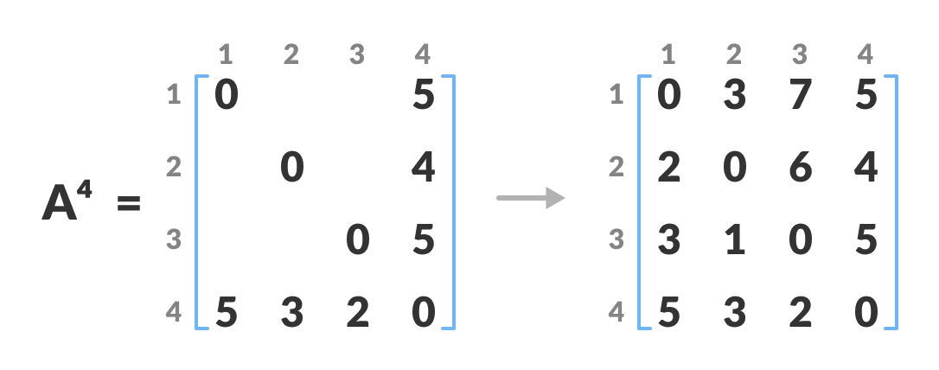
Calculate the distance from the source vertex to destination vertex through this vertex 4.
5. A⁴ gives the shortest path between each pair of vertices.
Slide No.

Slide 56
Floyd-Warshall Algorithm
n = no of vertices
A = matrix of dimension n*n
for k = 1 to n
for i = 1 to n
for j = 1 to n
Ak[i, j] = min (Ak-1[i, j], Ak-1[i, k] + Ak-1[k, j])
return A
Slide No.

Slide 57
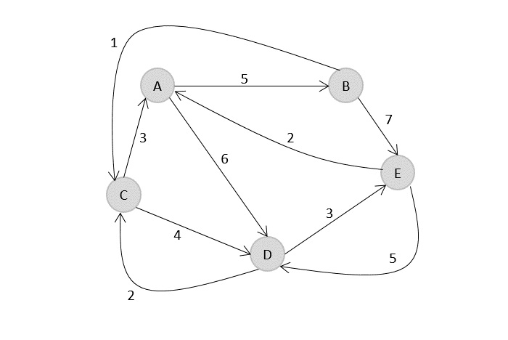
Example 2
Slide No.

Slide 58
Floyd Warshall Algorithm Complexity
Time Complexity
There are three loops. Each loop has constant complexities. So, the time complexity of the Floyd-Warshall algorithm is O(n³).
Space Complexity
The space complexity of the Floyd-Warshall algorithm is O(n²).
Slide No.

Slide 59
Floyd Warshall Algorithm Applications
To find the shortest path is a directed graph
To find the transitive closure of directed graphs
To find the Inversion of real matrices
For testing whether an undirected graph is bipartite
Slide No.

Slide 60
Slide No.

Slide 61
Slide No.

Slide 62
Slide No.

Slide 63
Slide No.

Slide 64
Slide No.

Slide 65
Slide No.

Slide 66
Slide No.

Slide 67

<Session Name>: Source
https://www.geeksforgeeks.org/
Slide No.

Slide 68

Time for a Break !
Slide No.

Slide 69

Any Doubts/Questions
Slide No.

Slide 70

Thank You

Slide 71








Icons To Be Used (Suggestions Only)
Hands on Exercise
Doubts/ Questions
Tools
Coding Standards
Test Your Understanding
Reference
A Welcome Break
Contacts
Demonstration
Slide No.

